Slide 1

Lesson 2: Homework Review

Slide 2
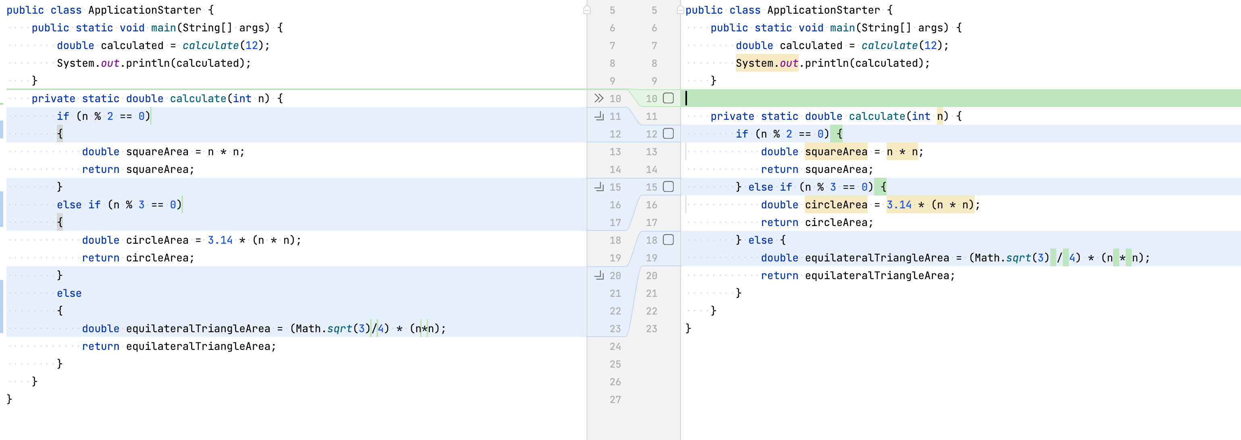
Follow formating rules

Slide 3
Use constants and inline variables

Slide 4
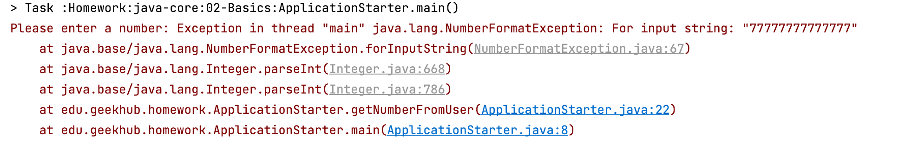
If you implement input make shure that all needed validations exists

Slide 5
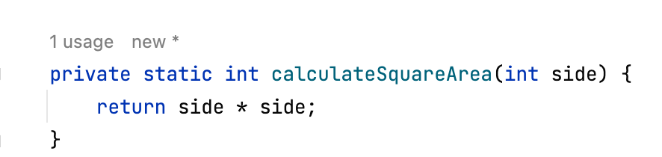
Devide functionality by methods
And specify method paramethers name
Side but not n

Slide 6
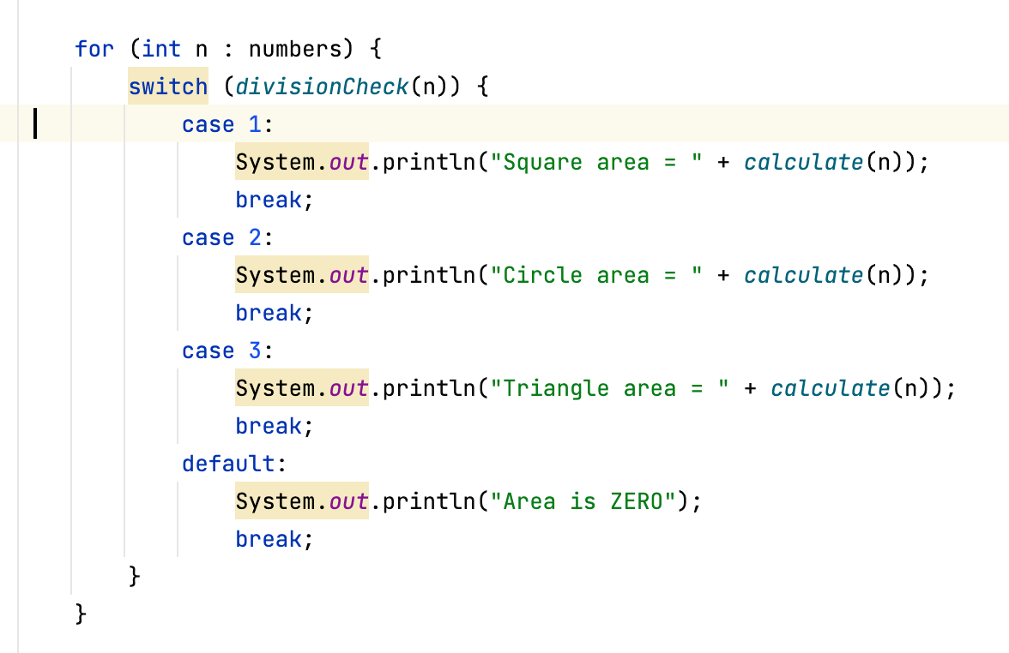
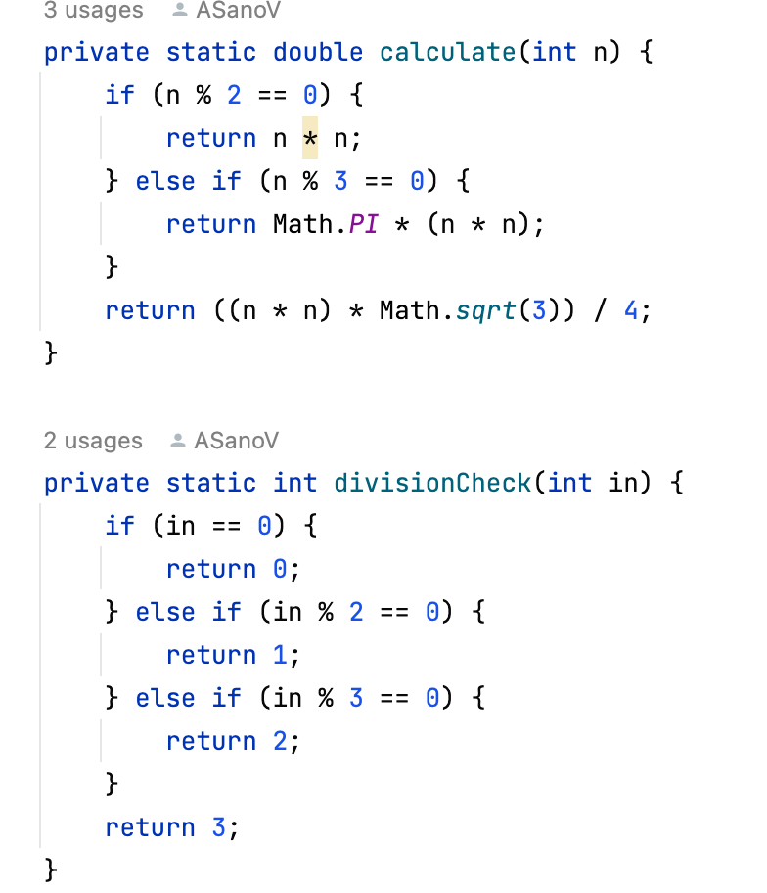
One check is enough

Slide 7
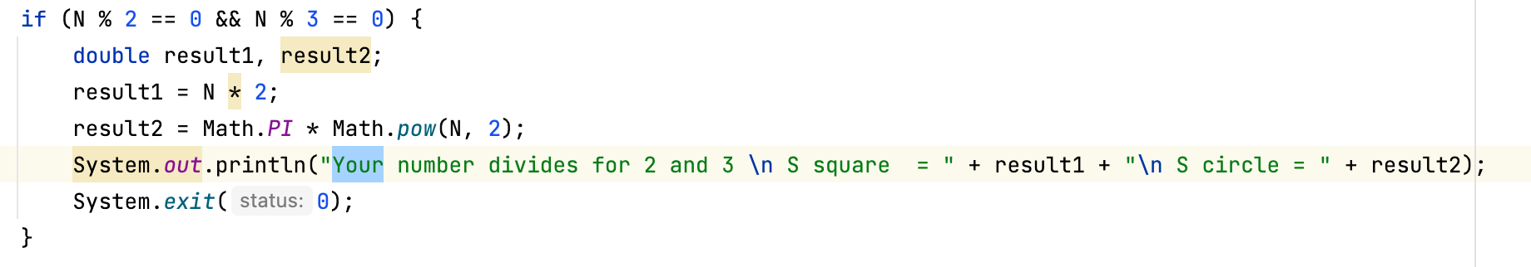
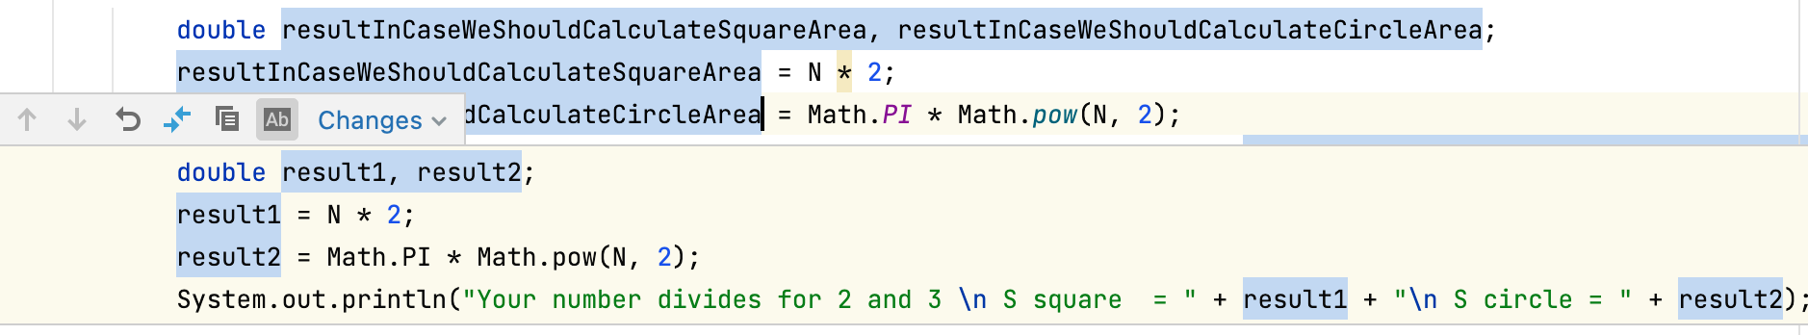
Naming = everything
Why in upper case????

Slide 8

No pushed commits = no review

Slide 9
Logical error also error
But no area = side*2

Slide 10

Two times without homework = chill

Slide 11
Thanks!
Find us in Slack:
@Bohdan Cherniak
@Vladyslav Nikolenko
@Volodymyr Vedula

